Slide 1
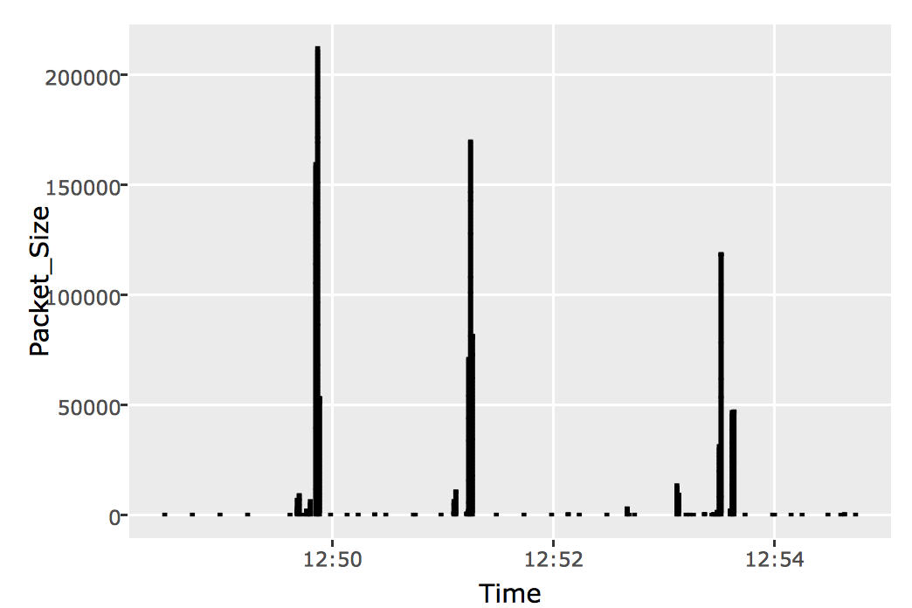
1
2
3
Passive scan
Parse traffic
Import,
Tidy,
Visualize data
BTLE Devices
Plots
.pcap
.csv
WiFi Devices

Slide 2
3
2
1
Import,
Tidy,
Visualize data
Parse traffic
Passive scan
Plots
BTLE Devices
.csv
.pcap
WiFi Devices

